Slide 1

Automating Data Cleaning with Python
DSA0503 –QUERRY PROCESSING
PRESENTED BY :
HARIHARAN G(192424156)
NAVEEN V(192424126)
VISHWA T(192424180)
GUIDED BY:
Dr .ANURADHA C

Slide 2
1. Abstract
Data cleaning is an important step in data analysis because real-world datasets often contain missing, duplicate, inconsistent, and invalid values. This project demonstrates how Python and the Pandas library can be used to automate the data-cleaning process. The customer dataset contains problems such as duplicate records, missing ages and emails, invalid ages, inconsistent city names, uppercase emails, and negative purchase amounts. The proposed system identifies and handles these issues automatically, producing a clean and consistent dataset suitable for further analysis.

Slide 3
2. Introduction
Data cleaning is the process of detecting and correcting inaccurate, incomplete, duplicate, or inconsistent data.
Manual data cleaning can be time-consuming and error-prone, especially when working with large datasets. Python provides powerful libraries such as Pandas that can automate common cleaning operations.
This project uses Python to clean a customer dataset and demonstrate how data-quality problems can be handled systematically.

Slide 4
3. Literature Review
Pandas is widely used for data manipulation and preprocessing in Python. It provides functions for detecting duplicates, handling missing values, filtering invalid records, and transforming data.
Data preprocessing studies show that data quality has a major effect on the reliability of data analysis and machine-learning models.
Common data-cleaning techniques include missing-value imputation, duplicate removal, data validation, text standardization, and handling abnormal values.
Automation makes these operations repeatable, faster, and less prone to manual errors.

Slide 5
4. Objectives
To identify data-quality problems automatically.
To remove duplicate customer records.
To handle missing and invalid age values.
To handle missing email values.
To standardize email and city formats.
To detect and handle negative purchase amounts.
To generate a clean dataset suitable for further analysis.

Slide 6
5. Problem Statement
The customer dataset contains several data-quality problems that can affect the accuracy of analysis.
The main problems are:
Duplicate record: Customer C105 appears twice.
Missing Age: C104 and C112 have missing ages.
Invalid Age: Age 150 is unrealistic.
Negative Age: C107 has an age of -5.
Missing Email: C106 and C113 have missing emails.
Uppercase Email: MEENA@GMAIL.COM is not consistently formatted.
City Inconsistency: Chennai, chennai, and CHENNAI are used.
City Inconsistency: Madurai and MADURAI are used.
Negative Purchase: C114 has a purchase amount of -5000.

Slide 7
6. Proposed Solution
The proposed solution uses Python and Pandas to create an automated data-cleaning pipeline.
The process includes:
Load the customer dataset.
Detect and remove duplicate records.
Identify invalid ages.
Replace missing and invalid ages using the median age.
Replace missing emails with "Unknown".
Convert emails to lowercase.
Standardize city names using proper capitalization.
Detect negative purchase amounts and replace them with 0.
Display the cleaned dataset.

Slide 8
Work flow
1. Data Input Module
Reads the customer_data.csv file using Pandas.
2. Duplicate Detection Module
Identifies and removes duplicate customer records.
3. Missing Value Handling Module
Handles missing age and email values.
4. Data Validation Module
Detects invalid ages and negative purchase amounts.
5. Text Standardization Module
Converts emails to lowercase and standardizes city names.
6. Output Module
Displays the final cleaned dataset for further analysis.

Slide 9
Code working
1. Read CSV – pd.read_csv()
Reads the customer_data.csv file and loads it into a Pandas DataFrame.
Allows Python to access and process the customer data.
2. Remove Duplicates – drop_duplicates()
Detects and removes duplicate records from the dataset.
The duplicate record of customer C105 is removed.
3. Select and Modify Data – loc[]
Selects specific rows and columns based on a condition.
Used to identify invalid ages and negative purchase amounts.
4. Handle Invalid Ages – pd.NA
Ages below 1 or above 100 are considered invalid.
Invalid ages such as 150 and -5 are converted into missing values.

Slide 10
code working
5. Calculate Median – median()
Calculates the middle value of the valid age data.
The median is used to replace missing and invalid ages.
6. Fill Missing Values – fillna()
Replaces missing values with a specified value.
Missing ages are replaced with the median, while missing emails are replaced with "Unknown".
7. Convert Text to Lowercase – str.lower()
Converts all email addresses into lowercase.
Example: MEENA@GMAIL.COM becomes meena@gmail.com.
8. Remove Extra Spaces – str.strip()
Removes unnecessary spaces from the beginning and end of text.
Helps maintain clean and consistent text values.

Slide 11
Code explanation
9. Standardize Text – str.title()
Converts city names into proper title case.
chennai, CHENNAI, and Chennai become Chennai.
10. Handle Negative Values – loc[]
Identifies purchase amounts that are less than zero.
The invalid purchase amount -5000 is replaced with 0.
11. Display Data – display()
Displays the cleaned DataFrame in a readable table format.
Helps verify that all data-cleaning operations were successfully performed.

Slide 12
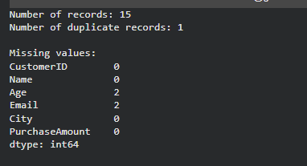
output

Slide 13
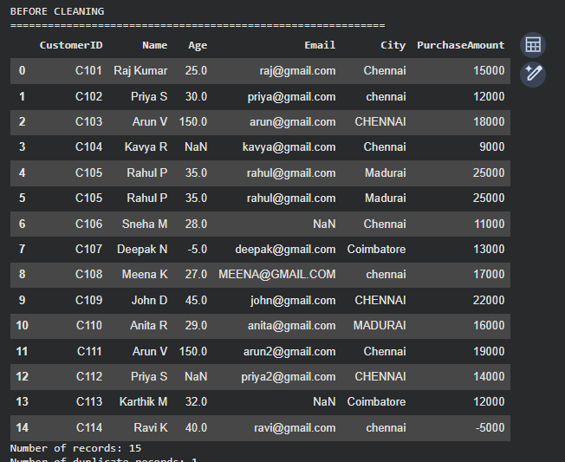
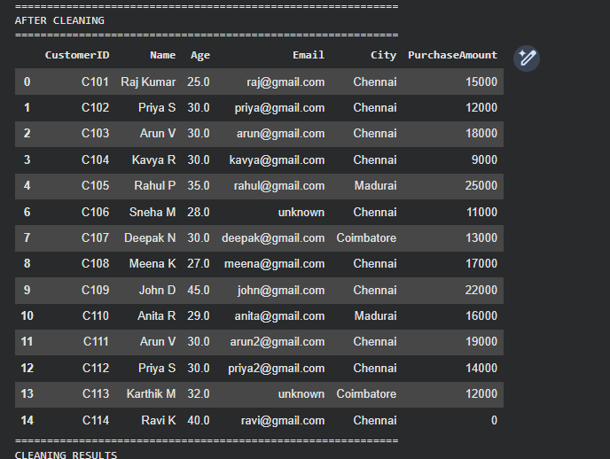
output

Slide 14
8. Observations and Result
Before cleaning, the dataset contains 15 records and several data-quality problems.
After cleaning:
Duplicate C105 is removed.
The dataset contains 14 records.
Missing and invalid ages are handled using median imputation.
Missing emails are replaced with "Unknown".
Emails are converted to lowercase.
City names are standardized to Chennai, Madurai, and Coimbatore.
The negative purchase amount of -5000 is replaced with 0.
The resulting dataset is more consistent and suitable for analysis.

Slide 15
9. Conclusion
Python and Pandas can effectively automate common data-cleaning tasks. The proposed system successfully handles duplicate records, missing values, invalid values, negative values, and inconsistent text formatting.
Automating these operations reduces manual effort and improves data consistency. The same approach can be applied to larger customer, sales, business, and machine-learning datasets.
Clean and reliable data provides a strong foundation for accurate analysis and better decision-making.

Slide 16
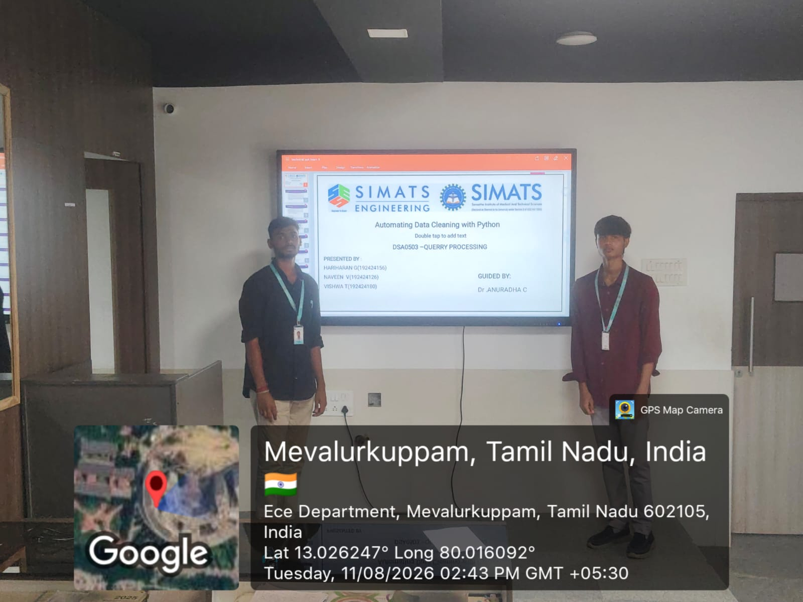
Presented photo

